Slide 1
The Missionary Voice
Perceptions of an Emerging Register
Joseph A. Stanley
Brigham Young University
Josh Stevenson
University of Virginia
Wendy Baker-Smemoe
Brigham Young University
98th Annual Meeting of the Linguistics Society of America
January 4, 2023
New York City, New York
Notes:
Good afternoon. Today I’m presenting on behalf of my student, Josh Stevenson, who wasn’t able to make it here today. This study is largely Josh’s work from his undergraduate honors thesis and I’m excited to tell you about it today.

Slide 2
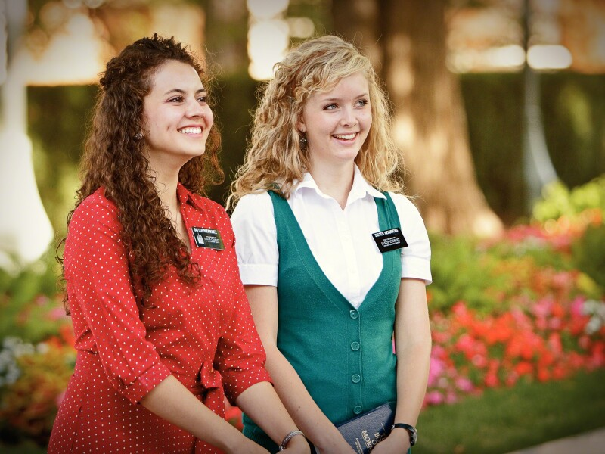
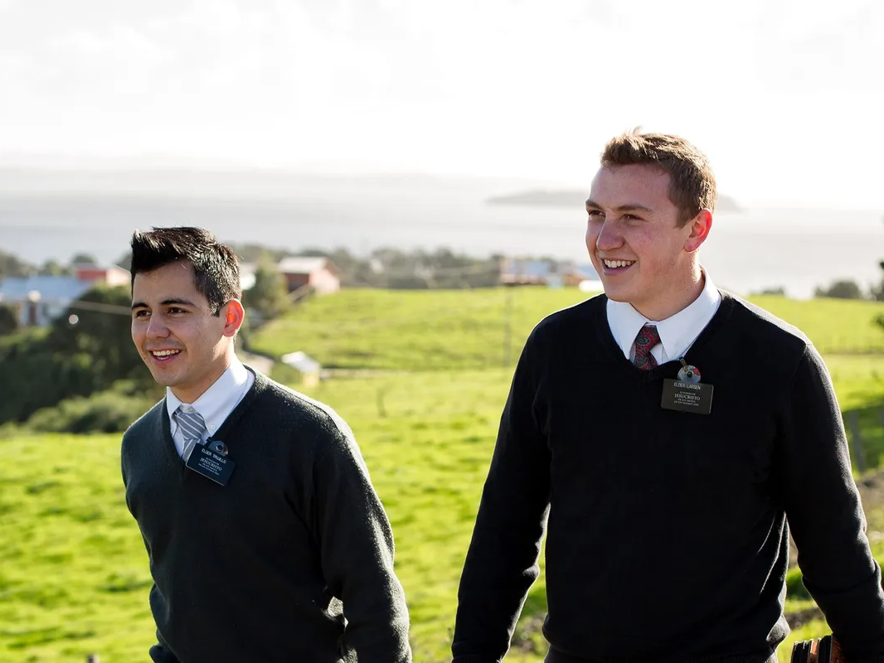
Latter-day Saint Missionaries
Terminology
Church of Jesus Christ of Latter-day Saints
(”Mormon” is now discouraged.)
Missionary service
18 month to two years, full-time, unpaid
strict dress and behavior rules
emotional, financial, spiritual preparation involved
a foundational, coming-of-age experience for many who serve
Notes:
Today’s presentation is on a particular way of speaking among certain members of the Church of Jesus Christ of Latter-day Saints. Specifically, today I’ll be telling you about Latter-day Saint missionaries, who you may encountered before. Let’s set aside any preconceived notions you may have about missionaries or their faith and explore what appears to be an emerging missionary-based register.
In essence, missionaries are Latter-day Saint volunteers who dedicate 18 months to two years to tell others about their faith. They’re assigned around the world and often have to learn a new language, are typically college-aged, and adhere to strict rules of dress and behavior. Their preparation encompasses emotional, financial, and spiritual aspects, and their service is considered a pivotal, coming-of-age experience. I suspect that these years of anticipation, prominence in our church culture, strict rules, and great personal significance all contribute to the emergence of a linguistic register.

Slide 3
Identity and Language
Per 3rd Wave sociolinguistics, identity expression happens through language.
Orientation towards a place (Reed 2020, Carmichael 2017)
Ethnic identity (Grieser 2022, Rodríguez 2022, Cheng, Jeon, & Kim 2023)
Sexual orientation (Podesva 2007)
Upward mobility (Labov 1963, Eckert 1989)
Political orientation (Schrimpf 2013, Hall-Lew, Coppock, & Starr 2010)
“Country” ideology (Hall-Lew & Stevens 2012, Podesva et al 2015)
Widespread usage > Association > Indexical
Missionary slang certainly spreads (Nygaard 2022)
What about phonetic variants?
Notes:
3rd Wave sociolinguistic research has shown that identity expression happens through language. People oriented towards a place may use more local variants of that place. Ethnic identity, gender expression, sexual orientation, social class, and political affiliations have all been shown to affect language. Even worldviews, like orientation towards a more “country” lifestyle, can influence what linguistic variants a person uses.
[*] All this happens because language is arbitrary. Countless random variants float around in any one speech community, but eventually one or more will gain traction. Outsiders may notice and associate those variants with the original group. Those variants then become “indexical” of that community, which outsiders can draw upon for aspiration or pejoration and insiders can use to reinforce their position within the group.
Given the prominence of Latter-day Saint missionaries in their church culture, and given the great personal significance of missionary service, we anticipate some influence on language. Nygaard (2022), for example, has documented an extensive list of missionary slang. Besides lexical items though, we might also expect other linguistic variants to spread across missionaries. And if outsiders hear those variants enough, they may begin to become indexical of missionaries.

Slide 4
Is there a “Missionary Voice”?
Can Latter-day Saints hear it?
What are the acoustic correlates of Missionary Voice?
Notes:
So, let’s delve into today’s research questions. First, is there a missionary voice? In other words, is there a particular way of speaking or list of linguistic variants that has become indexical of missionaries of the Church of Jesus Christ of Latter-day Saints?
[*] If so, can Latter-day Saints reliably hear it? Or perhaps, do missionaries consistently use it?
[*] Finally, what are the acoustic correlates of missionary voice?
We'll address these questions in two studies. The first is where we elicit impressions from people and the second is an experiment where listeners respond to recordings of missionaries.
I should note that we are focused on English-speaking, American missionaries. We don't doubt that missionary voice exists elsewhere and in other languages, but for the purposes of this study, we had to narrow the scope a little bit to what is probably the largest group of missionaries.

Slide 5
Study 1: Eliciting Impressions

Slide 6
Eliciting Impressions
Are other people aware of Missionary Voice?
Methods
Online survey, primarily recording oral responses (=more detail)
Asked people if they think missionaries “sound different.”
Only those with current or past affiliation with the Church of Jesus Christ of Latter-day Saints
Distributed via Reddit to Utah(-adjacent) subreddits
Demographics
366 people took the survey
146 responded to the Missionary Voice question
Notes:
In this first study, we simply wanted to see whether people were aware of missionary voice.
So, we set up a survey that, among other things, asked participants whether they think missionaries “sound different” in some way. This question was part of a larger survey that targeted residents of the mountain West—an area that has a large proportion of members of the Church of Jesus Christ of Latter-day Saints.
Only those with current or past affiliation with the church saw this question. While people who are not affiliated with this religion are the people missionaries talk to the most, it is those inside the religion that talk to the most missionaries.
[*] 366 people took the survey, 146 of which responded to the Missionary Voice question.

Slide 7
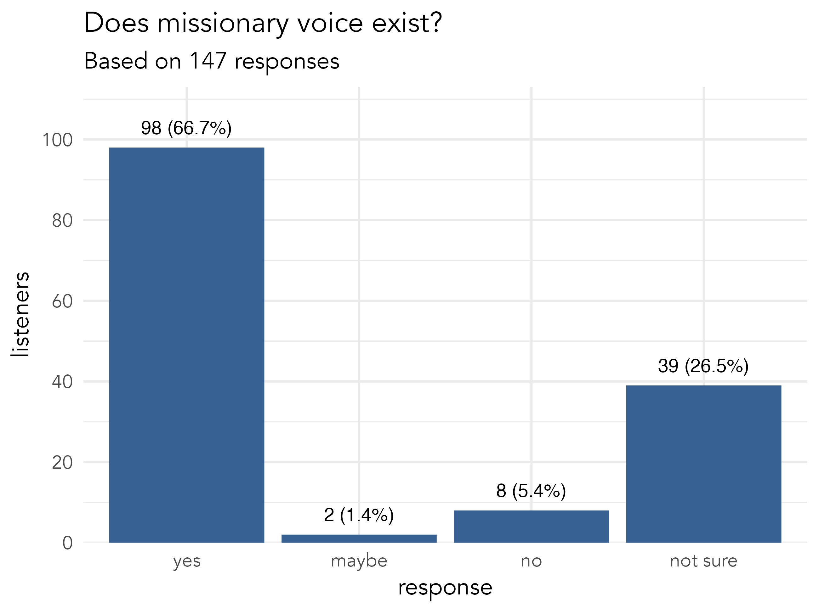
Notes:
Overall, we found that just about two-thirds of participants felt that, yes, missionaries do have a particular way of speaking. Only 5% of people said they did not. About a quarter of people weren’t sure and most of those explained because they don’t encounter missionaries enough to say either way.
So, this appears to be pretty strong evidence that people are aware of some sort of Missionary Voice.

Slide 8
Impressions: Linguistic Features
Pitch
lots of general comments about “tone”
higher, monotonous, uptalk
Intensity
quieter
Stress
lots of comments about emphasizing certain words
Rhythm
lots of general comments about rhythm or “cadence”
many long pauses, sometimes deliberate and awkward amounts
slower
Other
good grammar, more gesture, avoiding fillers
imitations were usually breathy with audible exhalation
Notes:
I had to skip this slide due to time, but here are the linguistic features people mentioned as part of missionary voice.

Slide 9
Perceptions
Generally positive from most people
good: calm, classy, mellow, nice, peaceful, pleasant, positive, relaxed, soft, soothing, wholesome, “everything is like a ray of sunshine”
compassionate: agreeable, approachable, empathetic, friendly, gentle, intentional, loving, non-judgmental, respectful, understanding
lively: confident, energetic, enthusiastic, excited
religious: faithful, earnest, humble, passionate, pious
authority: elevated, power, professional, reverent
Some neutral responses: formal, proper, calculated, serious, more scripted
Some negative
fake: artificial, disingenuous, fake, rehearsed, robotic, stiff, unnatural
“holier than thou”: condescending, pretentious
coercive: forceful, lecturing, manipulative, mild admonishment, persuasion
indoctrinated: brainwashed, conformity, cultish, emasculated, silly, stupid, unhelpful
Notes:
While not always precisely articulated, people generally had a good idea of what Missionary Voice was indexical of.
[*] The words people used to describe Missionary Voice were generally positive. People mentioned attributes that I’m umbrella-terming “good,” including pleasant, soothing, and my favorite, “everything is like a ray of sunshine.” It was described as compassionate-sounding, based on words like agreeable, respectful, and understanding. A variant of missionary voice was one that is livlier, with words like enthusiastic and excited. It’s no surprise there are religious interpretations as well, with people describing the person who uses missionary voice as faithful, humble, and pious. Finally, it evokes some gentle authority, with words like power and professional.
[*] Some responses were more neutral and people said it sounded formal, serious, and scripted.
[*] Finally, it’s not all a “ray of sunshine” though. Some people felt it was fake and described it as artificial, robotic, and stiff. Some felt it expressed a bit of a “holier than thou” attitude. Others felt it was coercive. Finally, some felt that people who use missionary voice sounded brainwashed, cultish, emasculated, silly, and stupid.
It’s important to note that most negative comments were said by a few ex-Mormons, potentially influenced by negative experiences in the faith. Meanwhile, almost all the practicing Latter-day Saints described Missionary Voice in overwhelming positive terms. I’m not saying the ex-Mormons’ opinions and perspectives don’t matter; in fact, in a future study, I’d like to look at how leaving the faith influences language and language perceptions.

Slide 10
Perceived reasons for using Missionary Voice
Pedagogical
turn-taking between missionaries
make sure listener follows
emphasize certain points
Spiritual
respect for the sacred topic
reverence for divine inspiration
express holiness through tone
demonstrate spiritual strength
Notes:
I had to skip this slide due to time, but here are some reasons people gave for why missionaries use missionary voice.

Slide 11
Perceptions of where it came from
From constantly giving the same prepared lessons
Perhaps more common when lessons were more memorized
No different than salesperson, teacher, customer service, public speaking, presentation, style-shifting
Emergence of a register
Imitating global church leaders
Passed on in micro-generations by trainers, leaders, and more experienced missionaries
It’s what idealized Latter-day Saints and a representatives of the church sound like
”It’s what spiritual discussions are supposed to sound like.”
Notes:
People have lots of opinions on why Missionary Voice sounds that way. Part it may be stemmed in memorization and rote repetition, given missionaries’ relatively limited repertoire of lessons, which leads to retelling the same anecdotes. 20 years ago, missionary lessons were actually word-for-word memorized, and it might have originated then.
[*] Other people said that Missionary Voice exists but it's no different than other style-shifted registers, like what is used by salespeople, teachers, customer service workers, or when public speaking.
[*] Finally, others speculated on where it came from. Some said it was from imitating global church leaders while others suggest it’s passed down in micro-generations from older trainers and leaders to newer missionaries. Others said that it’s just what they expect of idealized Latter-day Saints and representatives of the church. One person said that "It's what spiritual discussions are supposed to sound like," which I think is approaching the topic of indexicality. Basically, it's expected that missionaries sound that way because that's just what you do in those situations.
So overall, there’s a general awareness of Missionary Voice, and most people have a clear idea of what it indexes.

Slide 12
Study 2: Do people recognize Missionary Voice?
Notes:
In this second study, we explore missionary voice explicitly by running an experiment and having people respond to what they hear.

Slide 13
Finding Missionary Voice
Missionary Voice audio
Church-produced videos featuring people serving as missionaries at the time of filming.
Subjectively selected the ones that exemplified Missionary Voice.
Control audio
videos featuring BYU students or videos from another Christian university in the Western US.
Selected speakers who matched the missionaries in age, ethnicity, and variety of English.
Selected five-second portions containing semantically neutral content
20 recordings balanced by source (missionary vs. not) and gender (male vs. female)
Notes:
In this study, we wanted to play audio clips for people to evaluate. But we faced some challenges in doing so. It’s hard to elicit, the Missionary Training Center doesn’t allow visitors, and church policy doesn’t like research being done on missionaries. So, we got audio from church-produced videos found on their public-facing website, YouTube, and publicly available missionary instructional videos. Since we don’t really know the acoustic correlates of missionary voice yet, we selected the ones that we felt were the most exemplary.
[*] As a control group, we wanted to find recordings of people that were similar to the missionaries. So, we sought college-aged, White, Christians from the Western US. We ended up getting audio from videos featuring students from Brigham Young University (since it’s owned by the Church of Jesus Christ of Latter-day Saints) and another Christian university in the Mountain West.
[*] One reason why it was so hard to find recordings was because they had to contain content that either a college student or a missionary could reasonably say. So, it couldn’t be too religious or too worldly, which was a challenge. But for each clip we took a five-second portion to put into the survey.
[*] Unfortunately, we have no background information on the speakers featured in the videos. However, they all spoke something close to General American English, or at least what you’d expect from White Americans this age from the Intermountain West. In the end, we ended up with 20 recordings, balanced by source and gender presentation.

Slide 14
Survey Design
A very simple survey
Label the voices as from a “missionary” or a “student.”
All 20 recordings were included, in a random order.
Not told how many missionaries there were.
Also asked for what they heard to help them decide.
95 participants
Targeted Latter-day Saints; all but two were
35 male, 59 female, and 1 non-binary
median age: 24
77 were former missionaries
Notes:
We incorporated this audio into a simple survey. It played each clip and asked participants whether they thought it came from a missionary. All 20 clips were played in random order for each participant. There were 10 missionaries in the survey, but participants were not told that. And at the end, we asked them to write down what cues they used to make their decision.
[*] We wanted to recruit participants who are most familiar with missionaries, so Latter-day Saints themselves. The best place to do that was to distribute the survey at Brigham Young University and on some Facebook groups for Latter-day Saint congregations. 95 people took the survey, and all but two were Latter-day Saints. We had 35 men, 59 women, and one non-binary person and the median age was 24. 77 were former missionaries themselves.

Slide 15
One-sample t-test (based on a mean of 10)
t = 1.405, df = 95, p = 0.163
mean = 10.27
median = 10
std dev: 1.899
Notes:
We first wanted to see whether people could correctly guess which recordings were from missionaries. This plot shows the distribution of the number of correct answers people got. It looks an awful lot like a bell-curve centered around 10. A one-sample t-test based on a mean of 10 shows that, in the aggregate, these participants were no different than chance. Keep in mind if you were to flip 20 coins, you’d get a score close to 10. In other words, people performed terribly at this task!
Okay, so so far, it looks like people can’t pick out missionaries based on their voice alone. However, let’s delve into the recordings themselves to see if we can uncover some interesting patterns.

Slide 16
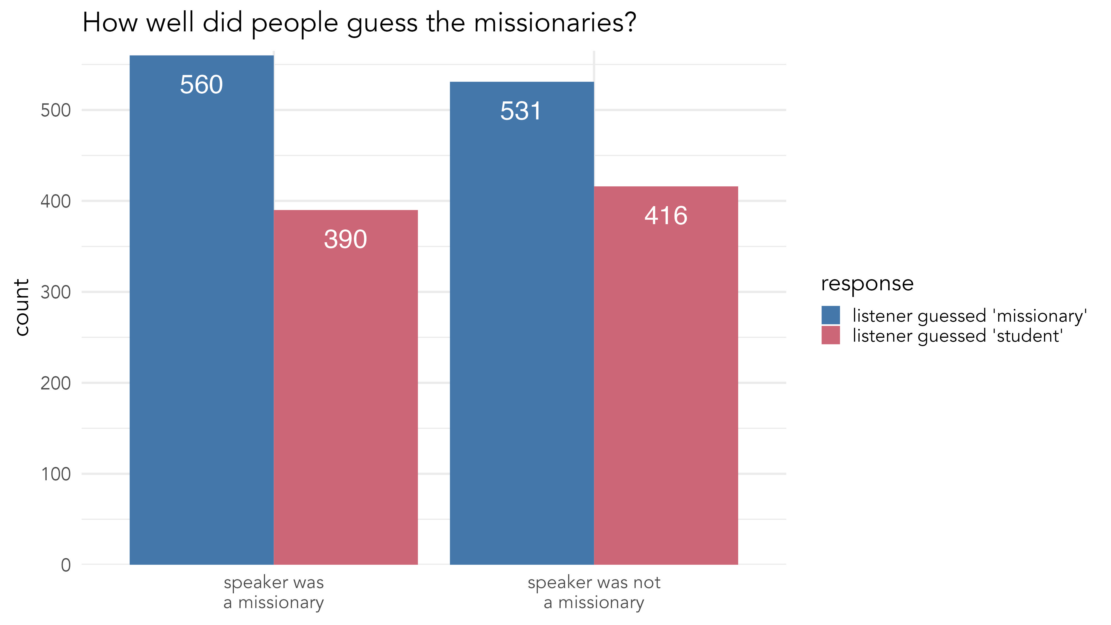
Chi-squared test of independence
χ² = 1.489, df = 1, p = 0.222
Notes:
We get the same results when looking at it from a different perspective. Here we see the distribution of guesses that someone is a missionary or not, based on whether they actually are. The fact that the two blue bars are taller than the red ones means that people guessed missionary a little more than not. But the fact that these two pairs of pairs are the same height as each other suggests that people didn’t mostly get missionaries wrong and the students right and vice-versa. No, instead, there was no association between whether someone was actually a missionary and whether they sounded like one. A chi-squared test supports this lack of association.

Slide 17
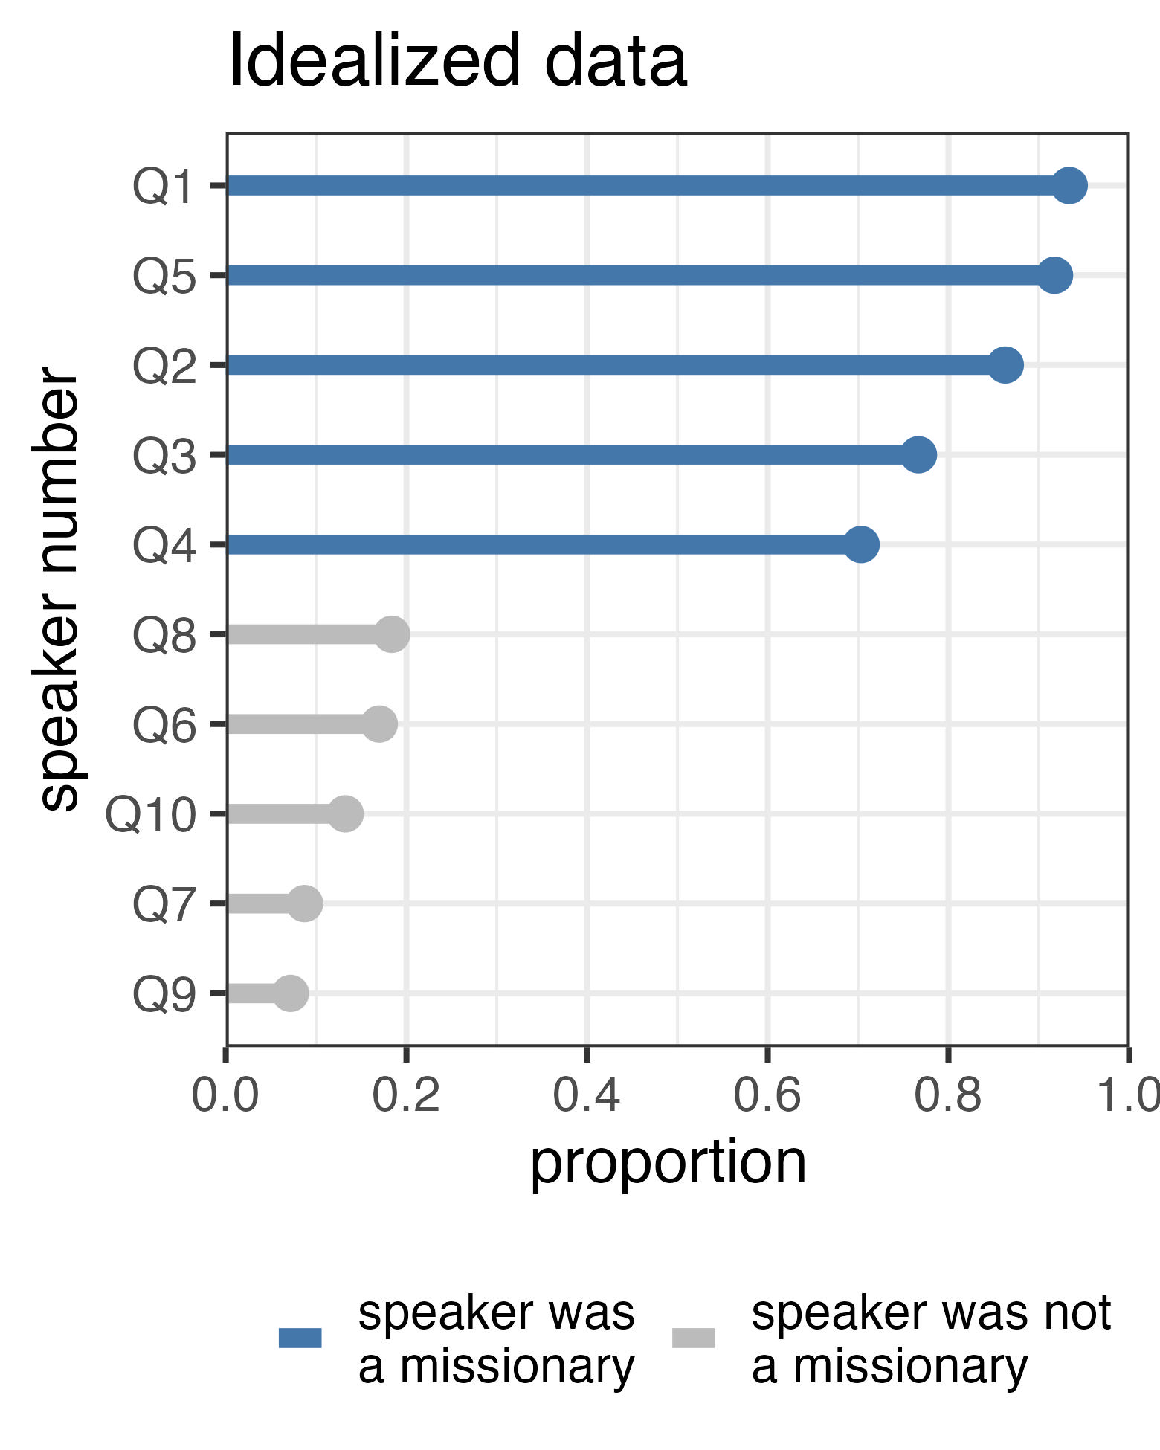
Notes:
Here’s a plot of some idealized data, to get you ready for the plot of the real data on the next slide. This plot shows the results if people could accurately hear missionaries based on their voice. We see clear clustering with the missionaries at the top with long blue bars and students at the bottom with short gray bars. Again, this is idealized data though.

Slide 18
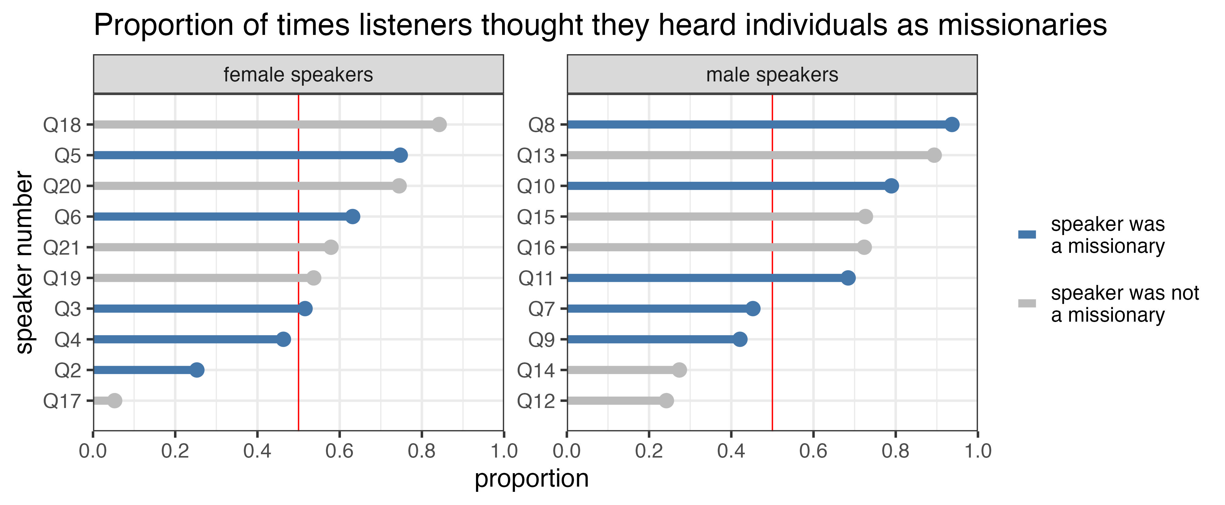
Notes:
Our data is much less tidy than that. Here, I’ve put the female speakers on the left and the male speakers on the right with the actual missionaries highlighted in blue. Compared to the idealized data, we see quite a bit of mixing rather than clustering and rather than mostly very long or very short bars, we see bars of all lengths, meaning that participants didn’t come to a consensus about most voices.
However, there are some people who were overwhelmingly thought of as missionaries or not, so it’s worth exploring those extremes to see what it is that people heard.

Slide 19
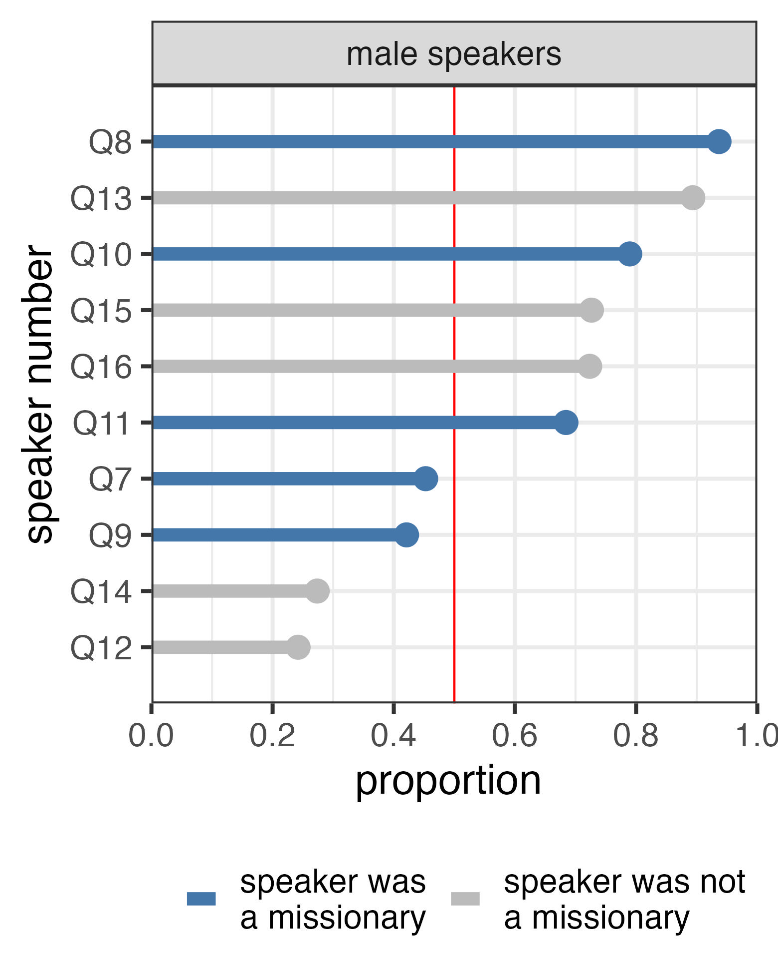
What did they hear in men?
Q8: pauses
“…grandma [672ms] who [95ms] passed away [120ms] recently…”
Q13: uptalk, spread lip articulation, filled pause
”…um, at ↗︎one point, somebody sent me a ↗︎text”
Q14: perhaps very slight disfluencies?
“cuz [t-] in my mind… get that bad, [w-] if you”
Q12: content? defiance? monophthongization?
“… [a^{ɛ}]’d say ↗︎↘︎↗︎no”
Notes:
The most missionary-sounding voice, Q8, was correctly identified as a missionary by 94% of participants. Let's hear what he sounds like [*]. I suspect what his pauses, notably the one after grandma, were what people reacted to. Recall that we asked people at the end what they heard and lots of people mentioned pauses.
For Q13, 89% believed he was a missionary, but he was not. Let’s hear him. [*] I think people heard the uptalk and what sounds to me like “spread lip” articulation, or “smiley voice.” Four people’s comments specifically mentioned smiling while talking or speaking out of the side of their mouth.
At the bottom of the plot, we see the speakers that were not rated very often as being missionaries. Q14 is a non-missionary and only 27% of participants thought he was. [*] The only thing I hear is maybe the very slight disfluencies. Recall that missionary voice is described as slow and deliberate. Also, compared to the previous two clips, this one sounds less rehearsed.
Finally, the least missionary-sounding male was Q12. [*] There’s nothing here that necessarily screams ”not a missionary” but there are a few clues. It might be the bit of defiance conveyed in the intonation on “no.” It could be the slight monophthongization in I and I’d. While many missionaries do come from the South, perhaps the most stereotyped ones come from Utah.

Slide 20
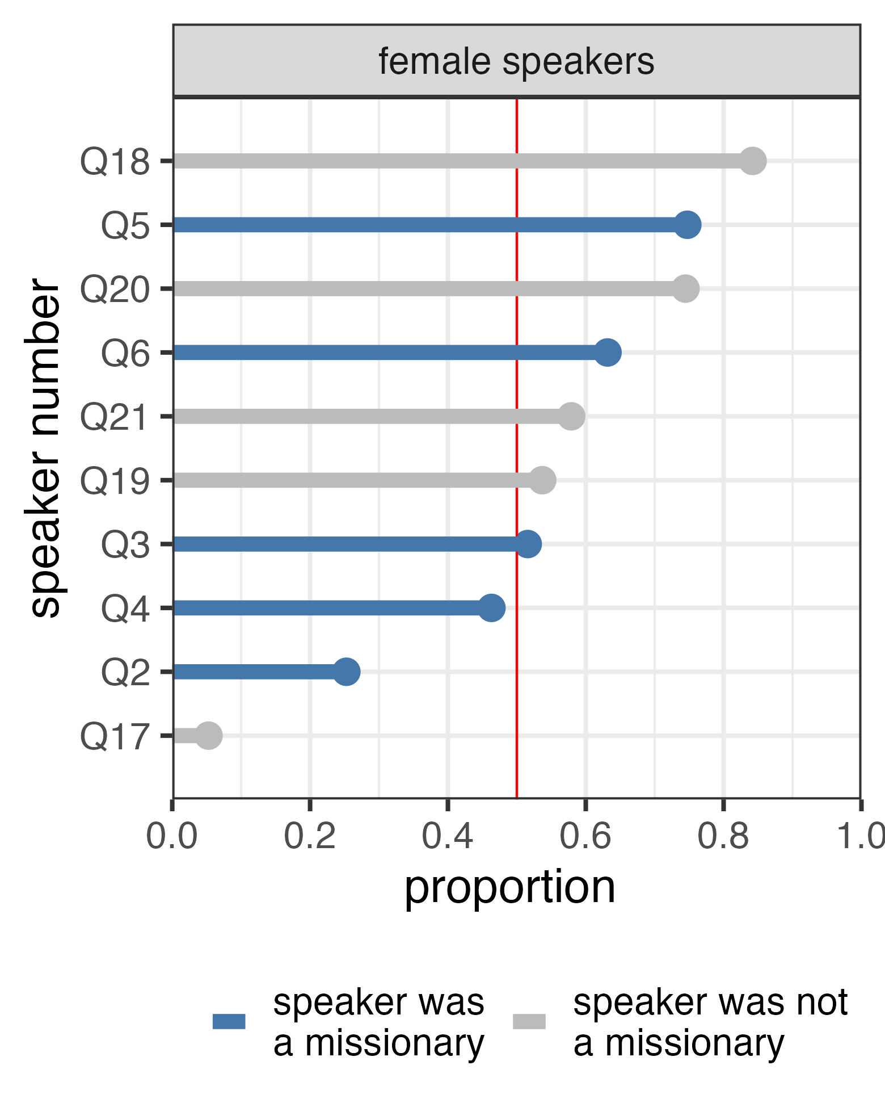
What did the hear in women?
Q18: semantics? optimism?
Q5: professional? smiling?
“My first time I [ɛ̰]ver went on a night d[a̰ɪ]ve…"
…you [ɹ̜]each your arm out…
“pitch bl[æ̞̙ ]ck”
Q2: informal? pitch variation? fast rate?
“so, I kinda just for↗︎got about it”
Q17: disfluencies? fast rate?
Notes:
Among the women, Q18 was the most frequently identified as a missionary (84%), even though she isn’t. [*] It’s hard to pinpoint what gave so many people the same idea, although one person specifically mentioned the term “founded on." Something about the semantic content sounds like something a missionary might say. Also, I think she sounds optimistic in some way, but I’m not sure what that means acoustically.
75% people were correct in guessing that Q5 was a missionary. [*] There is a small amount of creak in her voice and her low vowel in black is rather retracted, which have been shown to index California-ness and professionalism. There might also be some audible spread lip articulation in the r in reach.
Q2 was a missionary but 75% of people didn’t think she sounded like one. [*] I think people responded to the informal and off-the-cuff nature of what she’s saying, especially in the last phrase, “just forgot about it,” which was higher and louder. In general, there’s more pitch and amplitude variation and faster speaking rate than in most of the other clips.
Finally Q17 was the least missionary-sounding voice out of anyone, with just 5% of people thinking she was one. [*] She has a few disfluencies and false starts and speaks faster. She does use like, which people don’t respond well to in formal settings.

Slide 21
Missionary Voice
Not Missionary Voice
pauses, spread lip articulation, slower speech
indexing younger/Western: uptalk, retracted [æ], creak
professional and formal
These generally match the descript-tions people gave at the end of the survey.
false starts and disfluencies
any variety but Western American English?
informality
Notes:
So what IS missionary voice? Based on these audio clips, missionary voice has some suprasegmental things like pauses, spread lip articulation, and slower speech. It uses linguistic features characteristic of younger and Western speech, like uptalk, retracted [æ], and creak. In general, they sound more professional and formal. Here’s those four most quintessential clips [*]. Keep in mind, these acoustic correlates match what people said at the end of the survey.
But maybe Missionary Voice is partially defined as what it’s not. It does not have false starts or disfluencies, variants common in other regions, and informality. Let’s hear those clips that were the least missionary-sounding. [*]

Slide 22
Discussion
Notes:
So let’s tie these two studies together and discuss what we found.

Slide 23
Overview
Study 1: People are aware of it and know what it indexes.
Study 2: People kinda know it when they hear it.
Maybe not all missionaries use Missionary Voice
Maybe not the most representative audio.
Maybe not unique to missionaries.
People reacted not to missionaries but to Missionary Voice
Mostly suprasegmental features
Features that index the same things that people expect.
Notes:
In the first study, we found that most people affiliated with the Church of Jesus Christ of Latter-day Saints believe there is a missionary voice and could describe it well. Like any linguistic variant, it has a constellation of features it indexes. To me, this was a clear result in support of missionary voice.
[*] However, things get a little shaky in the second study when people responded to actual missionaries. In general, they didn’t do so well. BUT, there are some caveats. Maybe not all missionaries use missionary voice. We did have trouble finding clips, so maybe it shows up in more genuine settings. It may also be that what Latter-day Saints call missionary voice is used by others in other settings, such as when being recorded for a university-produced video.
[*] But, while people didn’t do well at identifying missionaries themselves, they did seem to do okay at identifying missionary voice. The linguistic features that correlated most strongly with people thinking the speaker was a missionary, are ones that match what they said at the end of the survey. Interestingly, they’re mostly supra-segmental features like rhythm, intonation, and voice quality. And what we know about what these features index lines up with the descriptions people used in the first study: generally good, compassionate, religious, and professional.

Slide 24
An Emerging Register?
The development of Missionary Voice
Existing formal register used in important situations.
Missionaries use this a lot.
It becomes associated with missionaries.
When used by missionaries, it indexes their missionary-like attributes.
It becomes expected of missionaries.
Missionary-like attributes are only expressed if in Missionary Voice.
Missionaries adopt Missionary Voice as part of their service.
Not limited to phonetic cues.
Missionary Voice is just one of several registers within the broader Latter-day Saint religiolect and there’s more to be explored.
Notes:
Perhaps what we’re seeing is that [*] there is a particular way of speaking that is used by missionaries and non-missionaries alike. It’s used in formal, high-stakes, or rehearsed speech. Young Westerners use this in certain situations like public speaking or being recorded. [*] Latter-day Saint missionaries also use it when interacting with pretty much any non-missionary. [*] But because missionaries use it so much, it has begun to be associated with missionaries. [*] Furthermore, it gets associated with missionary-like attributes like being good, compassionate, and spiritual. It seems like that has already happened.
The comment that stood out was the one that said that it’s just what is expected of missionaries in spiritual contexts. [*] So now rather than just being associated with missionaries, it’s expected of them. [*] For some people, you can’t be a good, faithful missionary without sounding that way. Missionaries, who are in an extremely important stage of life that they’ve been preparing years for want to do the best they can. [*] So, they pick up on these expectations and begin adopting these linguistic features. This association then becomes a self-fulfilling prophecy and we may see more exaggerated versions of missionary voice among those wanting to express greater spirituality.
[*] Something that was outside the scope of this study but that I think is closely tied in with all this, is that Missionary Voice extends to paralinguistics as well. Many people mentioned that gesture, posture, and overall demeanor changes during a lesson, particularly during important parts.
[*] So, what we’re seeing is perhaps the emergence of a register. It’s something that missionaries switch to in certain contexts, and involves a change in linguistic and paralinguistic production. We are currently working on studying what we’re calling Relief Society Voice and General Authority Voice, which are two other registers within the context of Latter-day Saint culture among women and men, respectively. So, Missionary Voice may be just one of many registers within the greater Latter-day Saint religiolect. There’s a lot more that we’d like to explore with missionary voice, including an analysis of authentic audio and video, and getting more nuanced reactions to those. But we hope that this simple study has convinced you of missionary voice.

Slide 25
References
Carmichael, Katie. “Displacement and Local Linguistic Practices: R-Lessness in Post-Katrina Greater New Orleans.” Journal of Sociolinguistics 21, no. 5 (November 2017): 696–719. https://doi.org/10.1111/josl.12253.
Eckert, Penelope. Jocks and Burnouts: Social Categories and Identity in the High School. New York: Teachers College Press, 1989.
Grieser, Jessica A. The Language of Professional Blackness: African Americans and the Linguistic Expression of Race, Place, and Class. Publication of the American Dialect Society 107. Durham, NC: Duke University Press, 2022.
Hall-Lew, Lauren, Elizabeth Coppock, and Rebecca L. Starr. “Indexing Political Persuasion: Variation in the Iraq Vowels.” American Speech 85, no. 1 (February 1, 2010): 91–102. https://doi.org/10.1215/00031283-2010-004.
Hall-Lew, Lauren, and Nola Stephens. “Country Talk.” Journal of English Linguistics 40, no. 3 (September 1, 2012): 256–80. https://doi.org/10.1177/0075424211420568.
Labov, William. “The Social Motivation of a Sound Change.” WORD: Journal of the International Linguistic Association 19, no. 3 (1963): 273–309. https://doi.org/10.1080/00437956.1963.11659799.
Nygaard, Auna. “Greenie-Be-Gone: An Exploration of Mormon Missionary Slang.” Presented at the American Dialect Society Annual Meeting, Washington D.C., January 8, 2022.
Podesva, Robert J. “Phonation Type as a Stylistic Variable: The Use of Falsetto in Constructing a Persona.” Journal of Sociolinguistics 11, no. 4 (September 2007): 478–504. https://doi.org/10.1111/j.1467-9841.2007.00334.x.
Podesva, Robert J., Annette D’onofrio, Janneke Van Hofwegen, and Seung Kyung Kim. “Country Ideology and the California Vowel Shift.” Language Variation and Change 27, no. 2 (2015): 157–86. https://doi.org/10.1017/S095439451500006X.
Schrimpf, Natalie. “Politics and Dialect Variation: A Sociophonetic Analysis of the Southern Vowel Shift in Middle TN.” LSA Annual Meeting Extended Abstracts 4 (May 7, 2013): 40. https://doi.org/10.3765/exabs.v0i0.777.
Reed, Paul E. “The Importance of Rootedness in the Study of Appalachian English.” American Speech 95, no. 2 (May 1, 2020): 203–26. https://doi.org/10.1215/00031283-7706532.

Slide 26
The Missionary Voice
Perceptions of an Emerging Register
Joseph A. Stanley
Brigham Young University
Josh Stevenson
University of Virginia
Wendy Baker-Smemoe
Brigham Young University
98th Annual Meeting of the Linguistics Society of America
January 4, 2023
New York City, New York

Slide 27
Bonus Slides

Slide 28
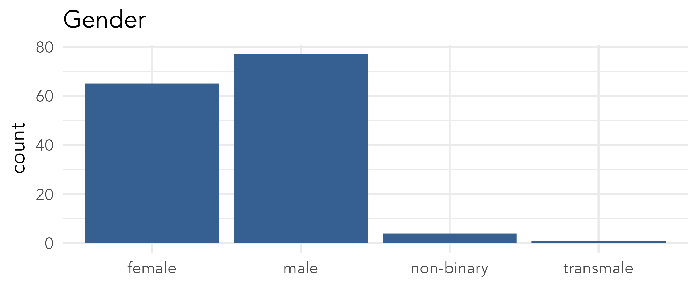
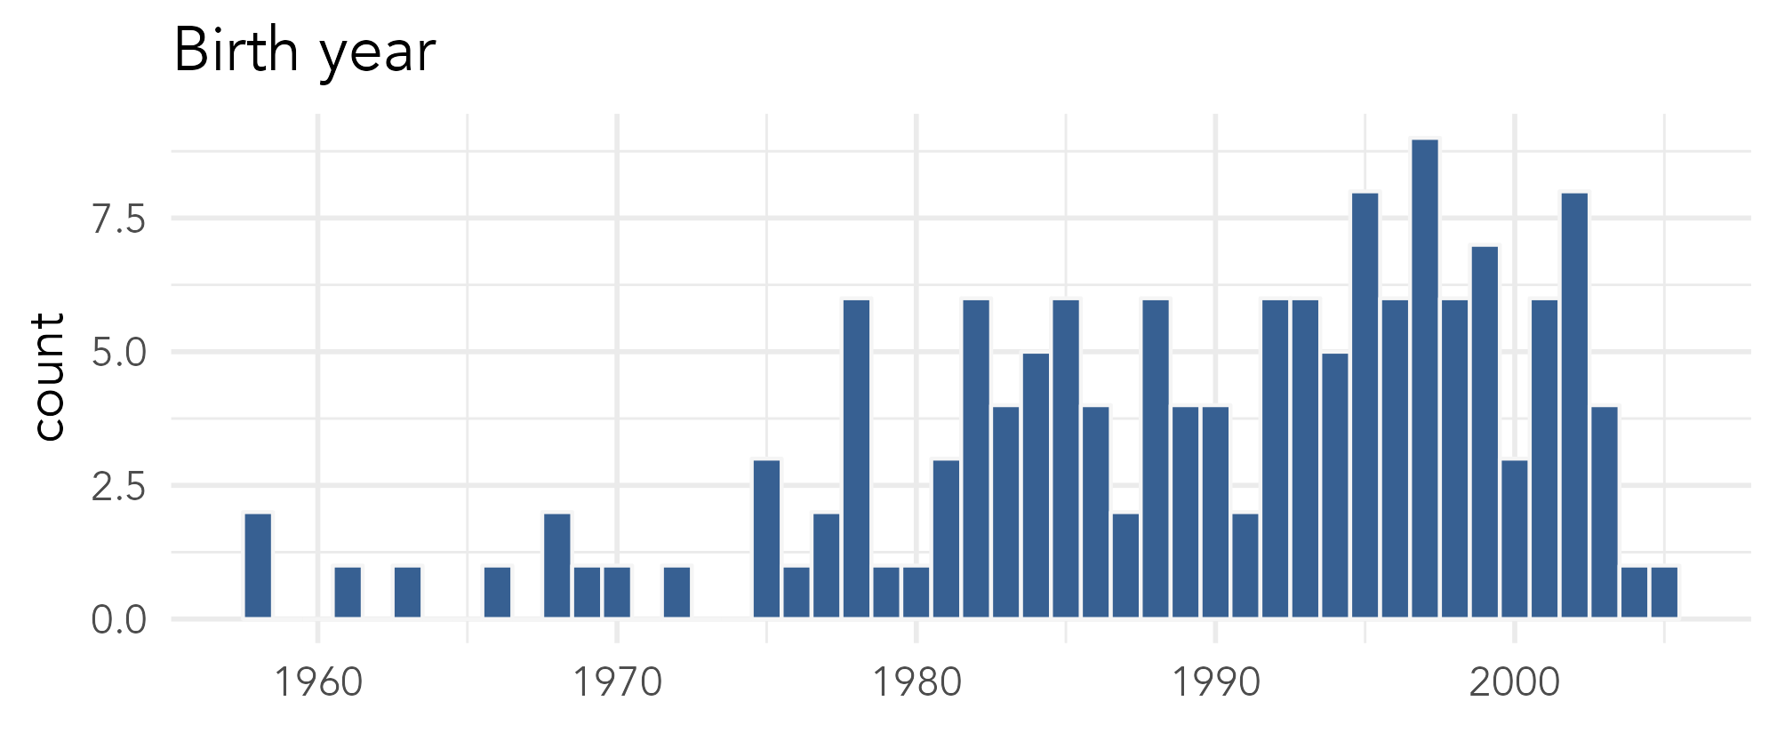
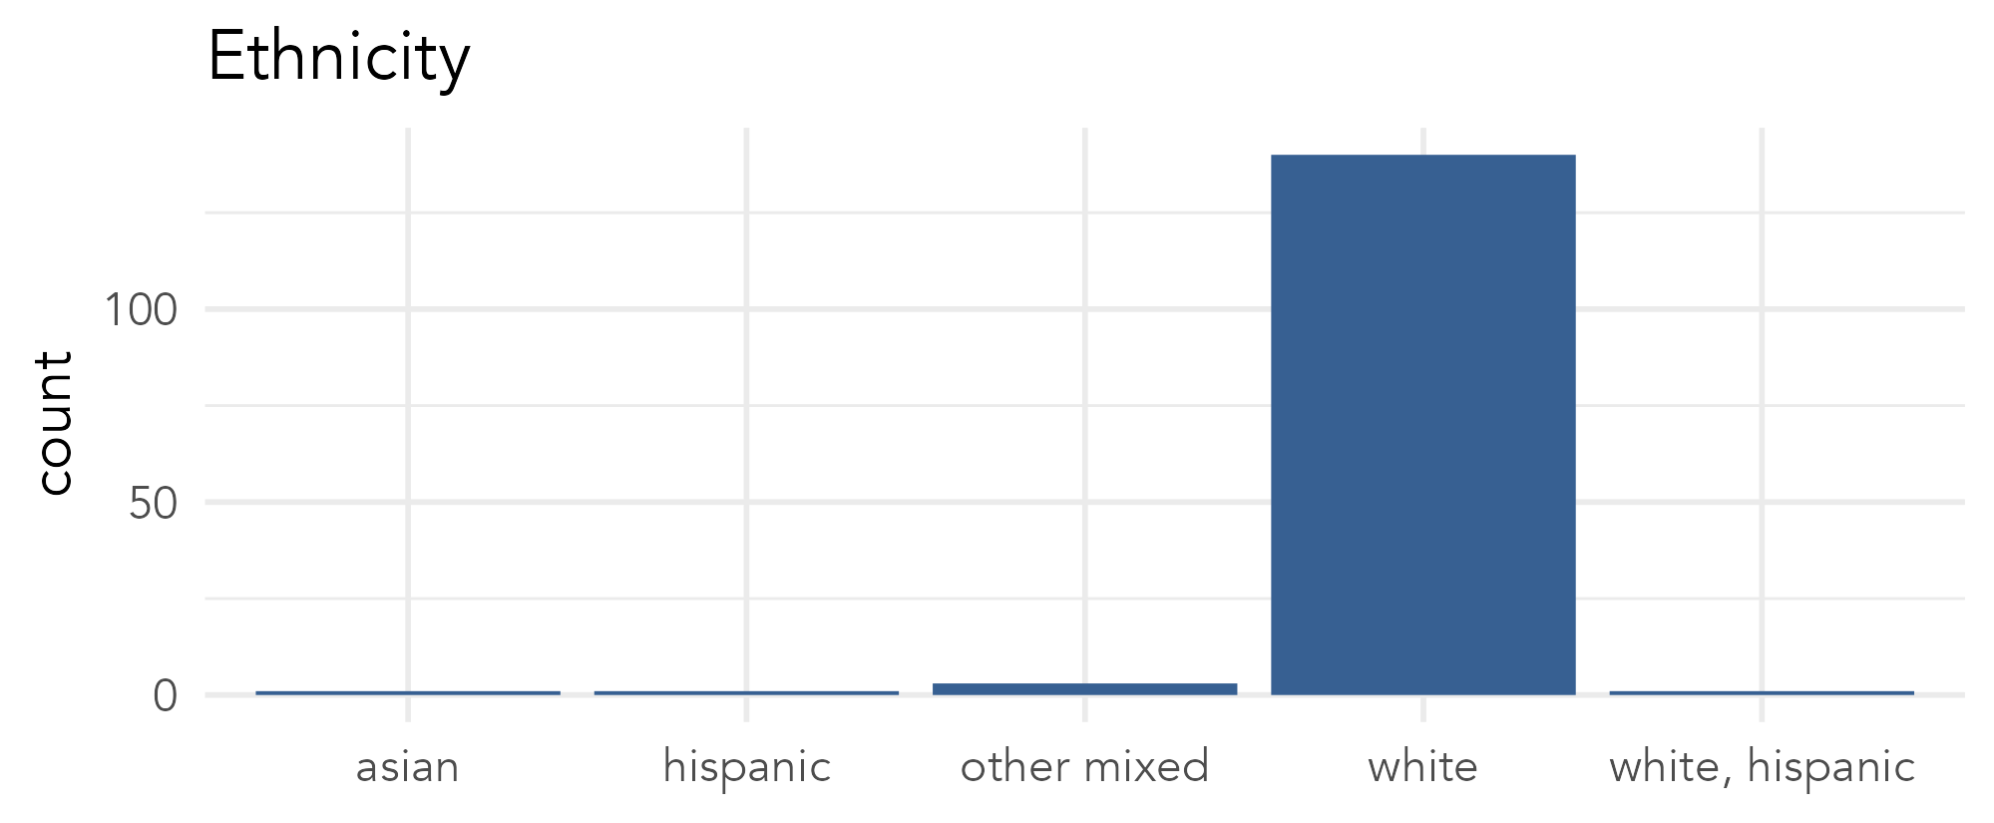
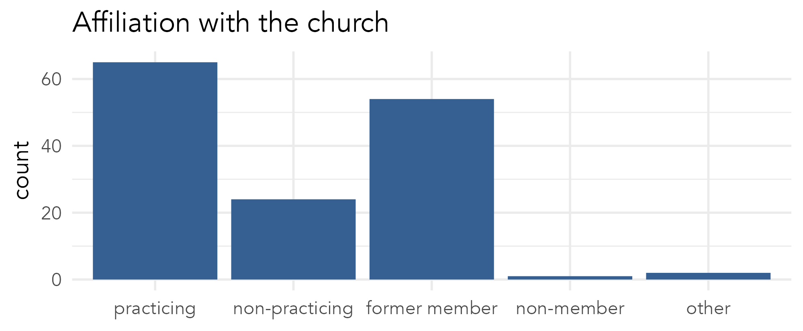
participant demographics (study 1)

Slide 29
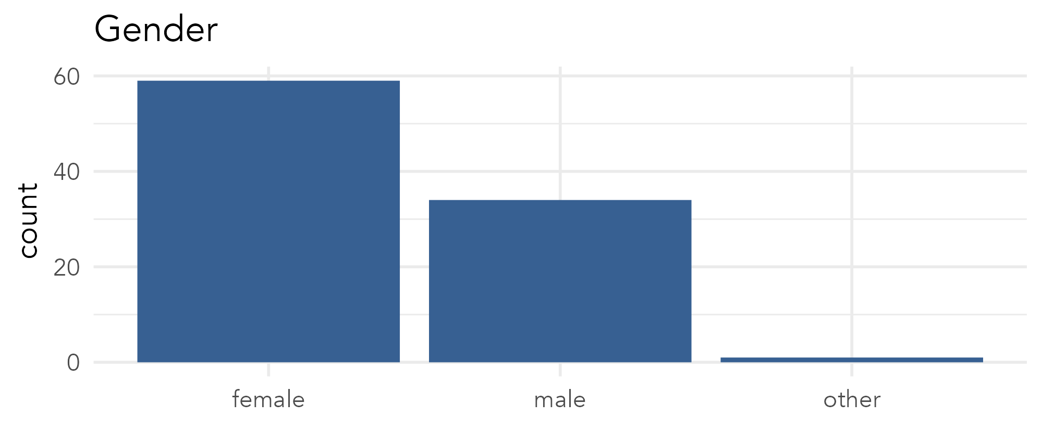
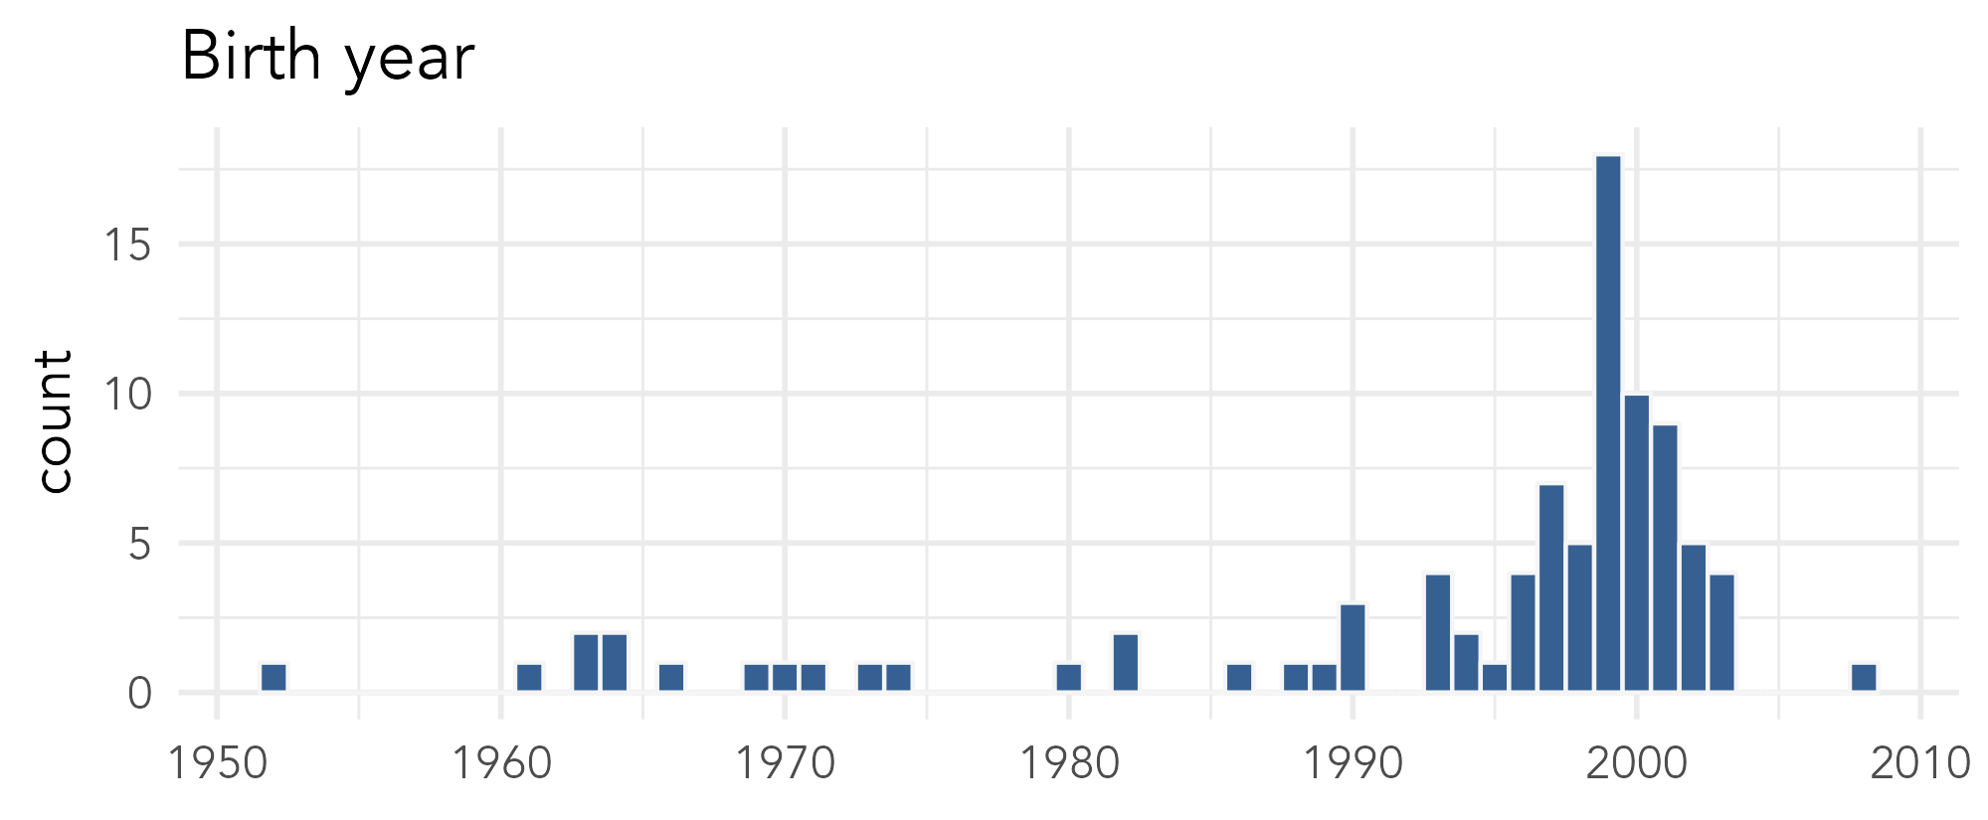
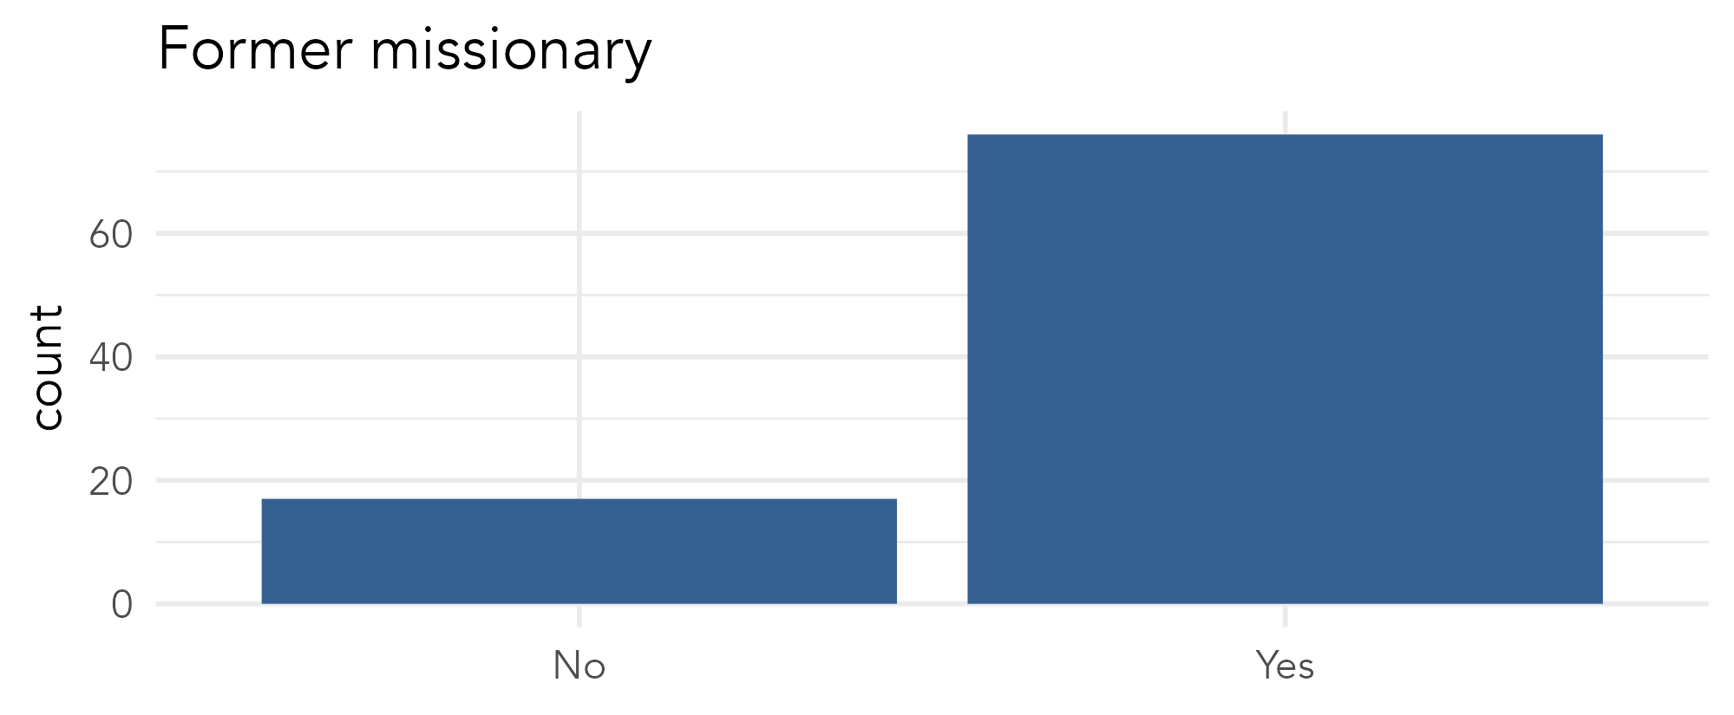
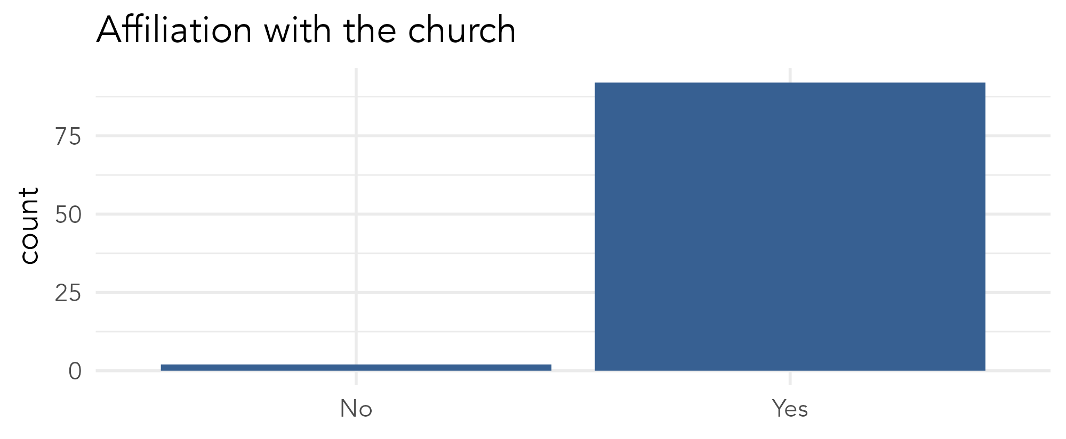
participant demographics (study 2)

